Slide 1

Optimized Tactical Routing for Unmanned Ground Vehicles
CDT Jacob Hyatt
Advisor: LTC Grymes, COL James, DR. Jane

Slide 2
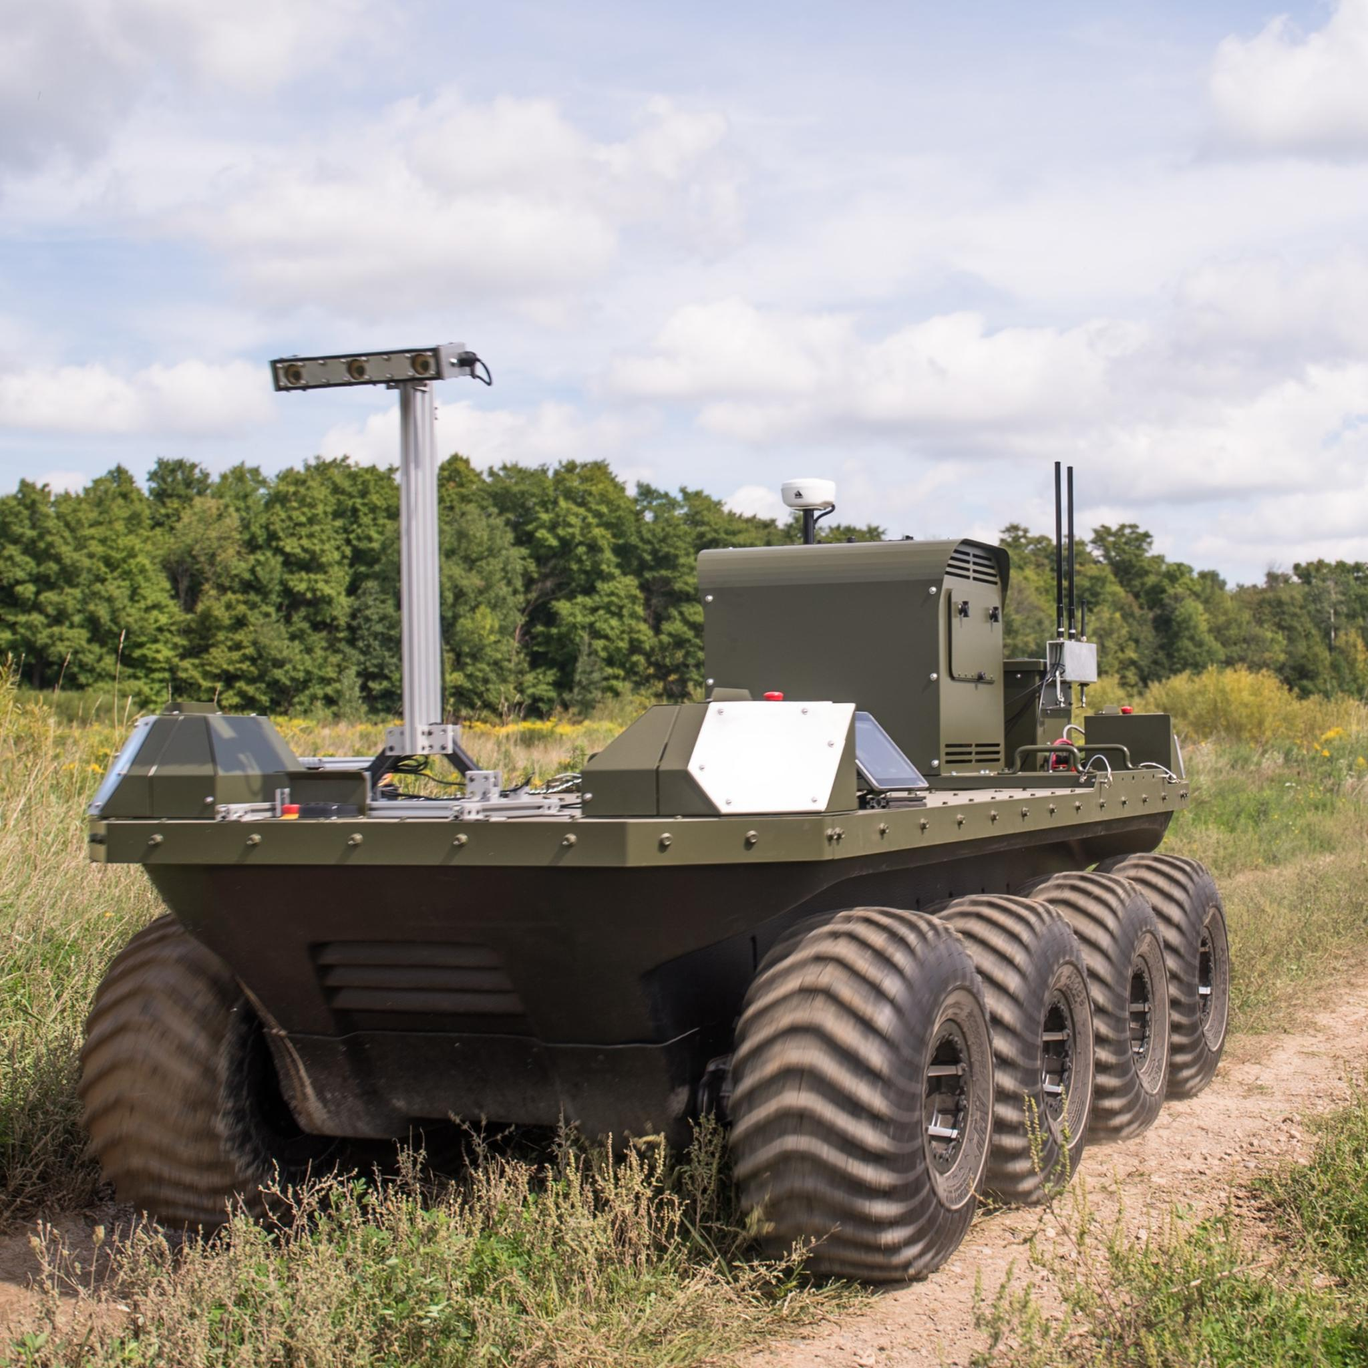
Scope
What is the optimal path for an unmanned ground vehicle in a contested environment?
Notes:
Talk about how this is a platform developed by clearpath robotics called Moose: Give tech specs

Slide 3
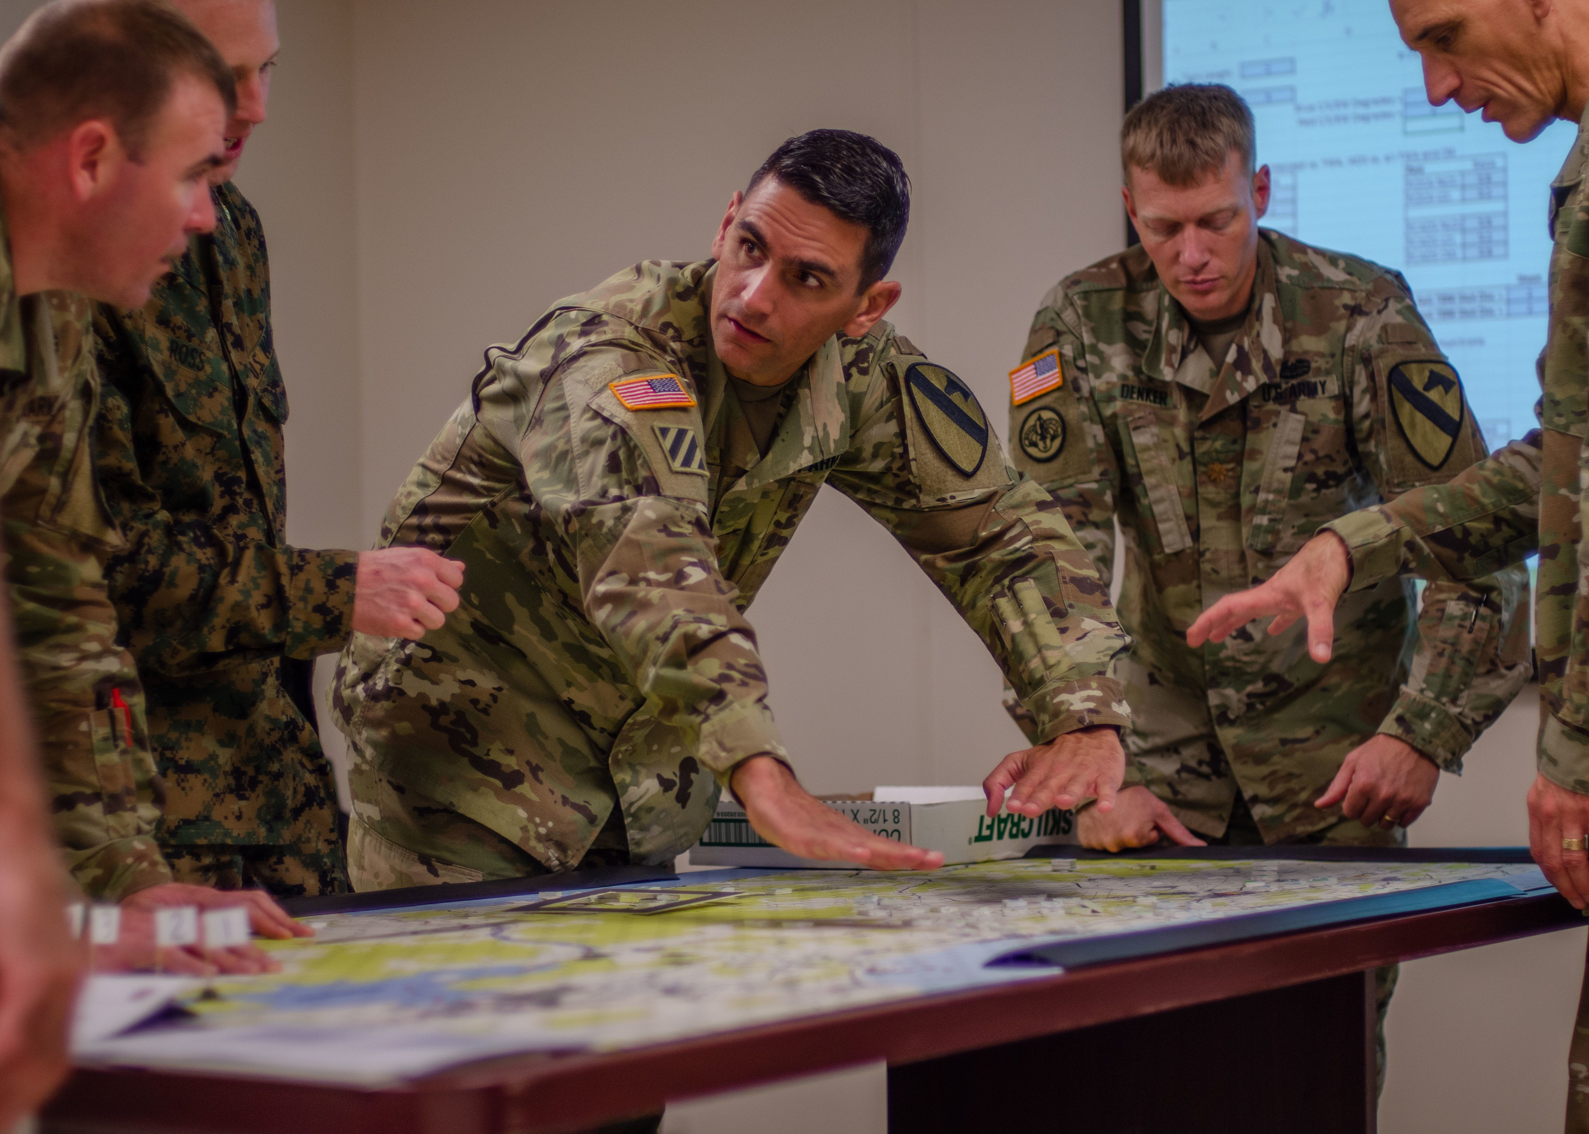
Use Case
Notes:
Rehearse on the motivation
Military planners plan routes they need to take
Finding the optimal path takes a lot of heavy lifting for path planners

Slide 4
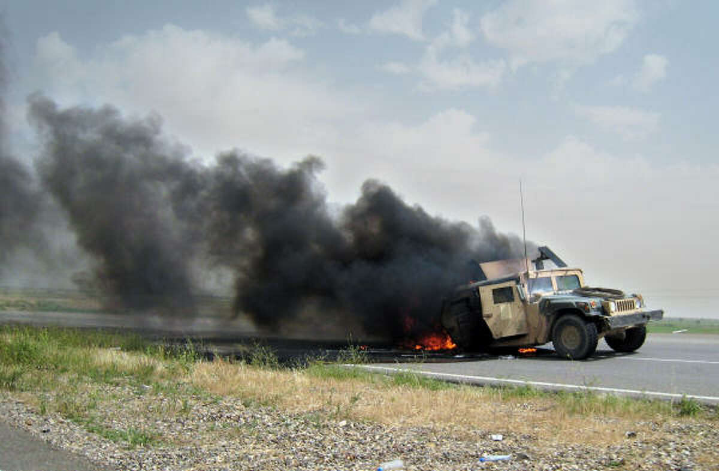
Use Case
Notes:
Detection, destroy, ambush, exposure
Make seamless with next slide

Slide 5
Previous Work
4
F
3
Top-Down View
2
S
1
E
E
Walking
Sneaking
Crawling
Probability of Detection
Notes:
Point out the three layers
Moving around an enemy
Probability of detection increases as you move up layers

Slide 6
UGV Adaptations
S
1
2
Top-Down View
E
3
4
F
Charging
Not Charging
Probability of Detection
Notes:
Taking the framework from the last problem to apply it to UGV
UGV have a set battery charge
UGV has a generator that offsets power use, but increase prob of detection due to noise created
UGV can charge using regenerative braking or a generator

Slide 7
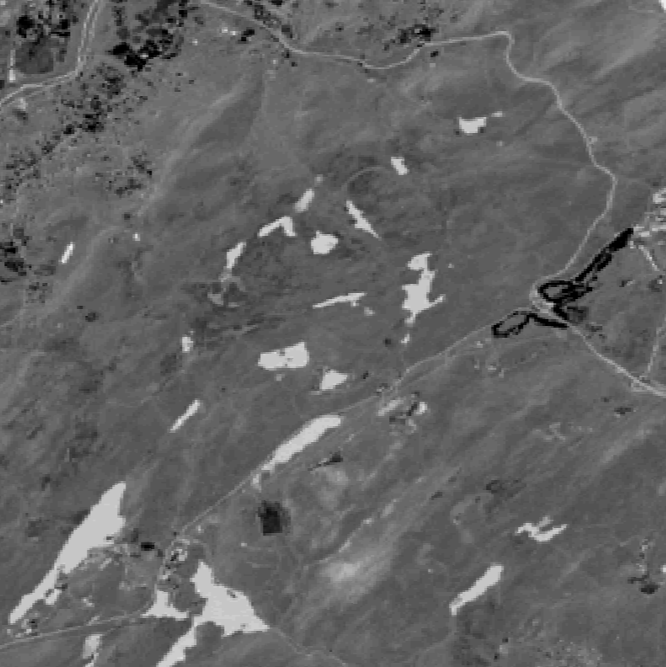
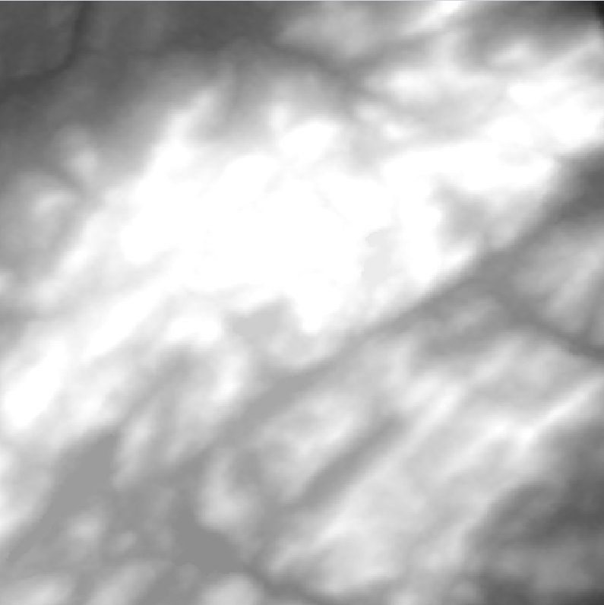
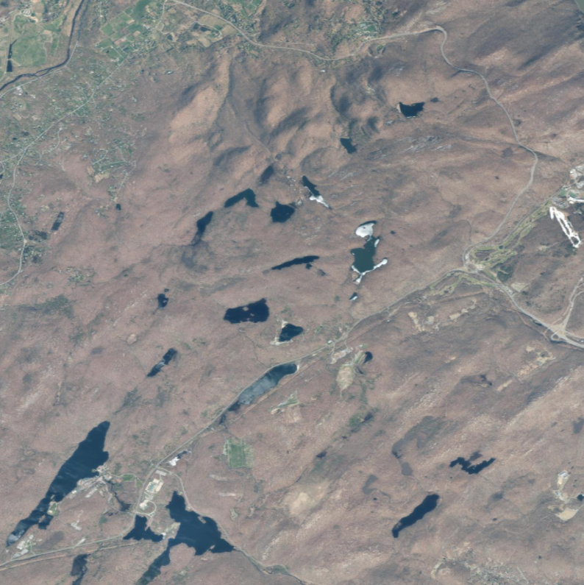


Satellite Imagery
NDVI
DEM
SAT
Notes:
General Methodology on how I get data

Slide 8
Node Field
Notes:
General Methodology
Multi-objective path function that utilizes detection and energy values
Contour map: introduces the terrain, valley of low vegetation
Detection field: yellow is a higher probability of detection, right on top of enemies means you are detected

Slide 9
Node Field
Notes:
General Methodology
Multi-objective path function that utilizes detection and energy values
Contour map: introduces the terrain, valley of low vegetation
Detection field: yellow is a higher probability of detection, right on top of enemies means you are detected

Slide 10
Enemy Placement
E
E
E
Notes:
General Methodology
Multi-objective path function that utilizes detection and energy values
Contour map: introduces the terrain, valley of low vegetation
Detection field: yellow is a higher probability of detection, right on top of enemies means you are detected

Slide 11
Edge Weights
Detection Cost
Energy Cost
E
E
E
Notes:
General Methodology
Multi-objective path function that utilizes detection and energy values
Contour map: introduces the terrain, valley of low vegetation
Detection field: yellow is a higher probability of detection, right on top of enemies means you are detected

Slide 12
Edge Weights
Detection Cost
Line of Sight
Noise
Distance from Enemy
Vegetation Coverage
E
E
E
Notes:
General Methodology
Multi-objective path function that utilizes detection and energy values
Contour map: introduces the terrain, valley of low vegetation
Detection field: yellow is a higher probability of detection, right on top of enemies means you are detected

Slide 13
Edge Weights
Energy Cost
Elevation Change
Mass of Vehicle
Wind
E
E
E
Notes:
General Methodology
Multi-objective path function that utilizes detection and energy values
Contour map: introduces the terrain, valley of low vegetation
Detection field: yellow is a higher probability of detection, right on top of enemies means you are detected

Slide 14
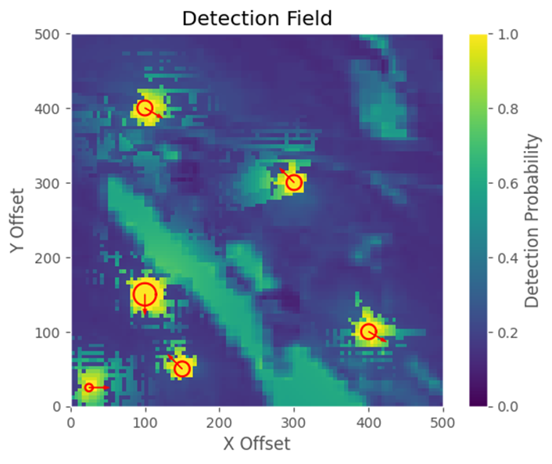
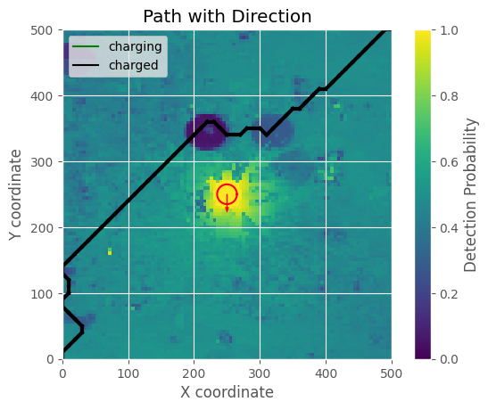
Detection Fields
This is what the model “sees”
for our detection functions
Notes:
Color scale on the right hand side that indicates ptrob of detection
visualization

Slide 15
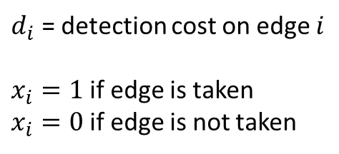
Optimization Function
$d_{i}$ = detection cost on edge $i$
$x_{i}=1$if edge is taken
$x_{i}=0$if edge is not taken
Julia as modeling language
Gurobi as solver
Notes:
Looks continuous but is really
Lower area is lower prob of det
Callout for di and x_i
Animate it

Slide 16
Constraints
Constraints
Inflow
Outflow
Time Considerations
Battery Constraints
Max capacity
Never below 0
Notes:
Looks continuous but is really
Lower area is lower prob of det
Callout for di and x_i
Animate it

Slide 17
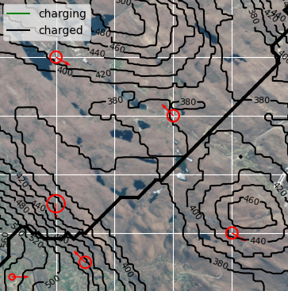
Solve
Notes:
Constraints
Discusses the constraints
Model in Julia
Solve with Gurobi

Slide 18
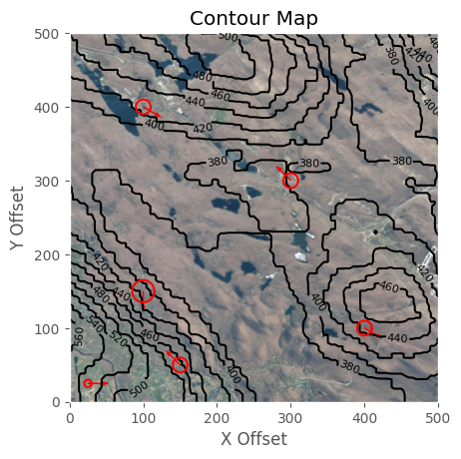

Methodology
Determine edge costs: detection and energy
Solve optimization function subject to energy constraints
Generate paths for leader consideration
Notes:
General Methodology
Multi-objective path function that utilizes detection and energy values
Contour map: introduces the terrain, valley of low vegetation
Detection field: yellow is a higher probability of detection, right on top of enemies means you are detected

Slide 19
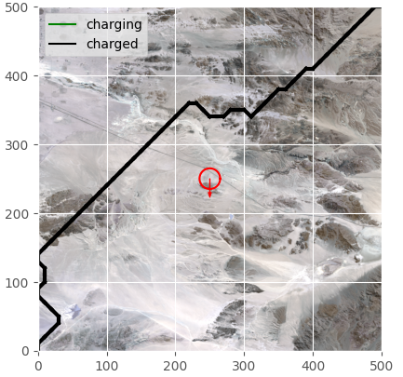
Results for Fort Irwin
Notes:
Point out the two separate equations
Alpha and beta are parameters that can be tuned to change the outcome of the function
Both d_i and E_i have a magnitude between 0 and 1
Minimize the cost function

Slide 20

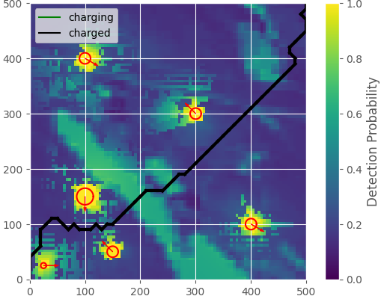
Results for West Point
Notes:
Show the graphics change in the model
Determine when its charging

Slide 21
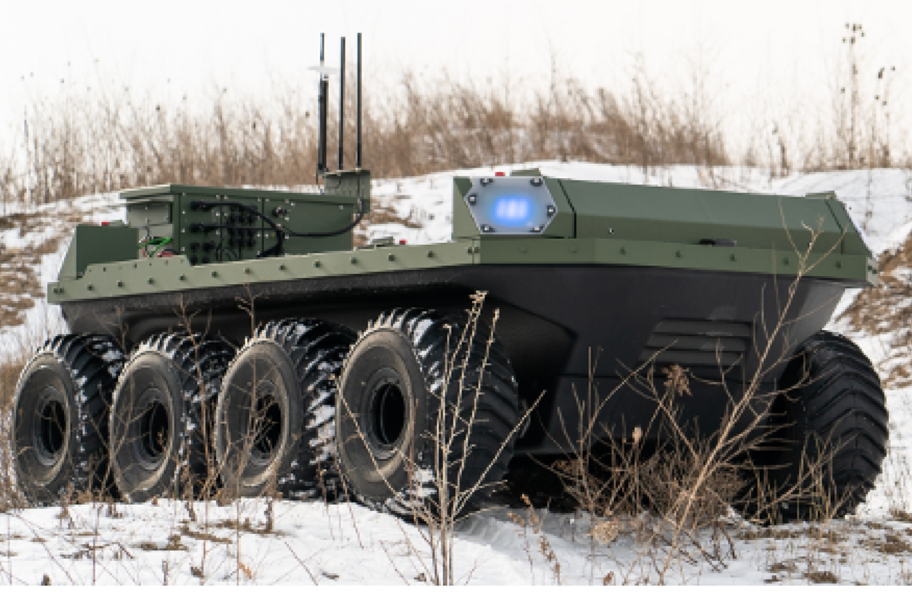
Next Steps
Write Paper
Ability to charge in place
Apply to real UGV

